Slide 1
Applications of Machine Learning
Dr. Noman Islam

Slide 2
What is Deep Learning?
Deep learning refers to neural networks with multiple hidden layers that can learn increasingly abstract representations of the input data¹
Increasingly learn complex patterns as progresses from one layer to another
An enormous number of applications
Google’s Self Driving Car, Image search
Facebook image tagging
Prisma’s image processing app
For a gentle introduction to machine learning and deep learning see the following NVIDIA’s article:
https://blogs.nvidia.com/blog/2016/07/29/whats-difference-artificial-intelligence-machine-learning-deep-learning-ai/
¹ https://elitedatascience.com/keras-tutorial-deep-learning-in-python

Slide 3
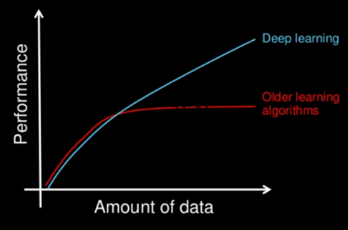
http://slides.com/shagunsodhani/keras2016#/3

Slide 4
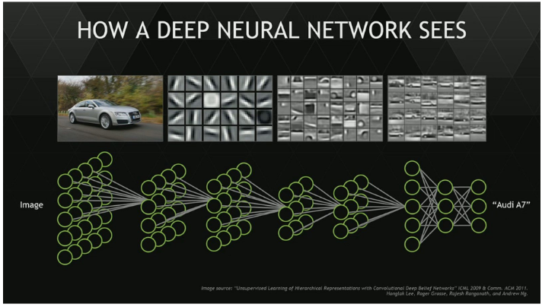

Slide 5
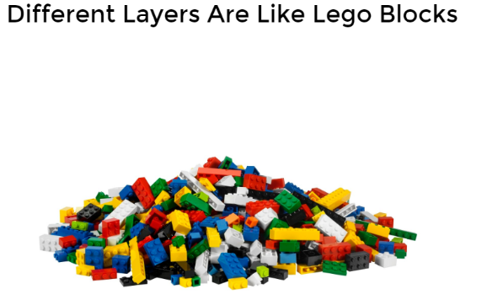
http://slides.com/shagunsodhani/keras2016#/6

Slide 6
Other libraries
brain.js
Torch
Caffe

Slide 7
Keras
The development on Keras started in the early months of 2015
Developed by François Chollet, Software Engineer at Google
Wraps the most popular machine learning frameworks Theano and Tensorflow
Other libraries like Lasagne chose to be a toolbox of utilities to work with Theano instead of wrapping it
requiring users to have extensive knowledge of Theano
Based on the minimalistic, modular approach to design ANN models

Slide 8
Features
Completely Independent of backend i.e. Theano / Tensorflow
Other similar libraries such as Lasagne requires have extensive knowledge of Theano
OO design
Every thing is object i.e. layers, model, optimizers
Allows for easy and fast prototyping (through total modularity, minimalism, and extensibility).
Supports both convolutional networks and recurrent networks, as well as combinations of the two.
Supports arbitrary connectivity schemes (including multi-input and multi-output training).
Runs seamlessly on CPU and GPU.

Slide 9
Prerequisite software
You have Python 2 or 3 installed and configured.
You have SciPy (including NumPy) installed and configured (e.g. via Anaconda).
You have Keras and a backend (Theano or TensorFlow) installed and configured.

Slide 10
Installation
Install anaconda
Download the distribution from https://www.continuum.io/downloads
Run the installer and follow the instruction
Install Tensorflow
Type the following line on command prompt:
pip install tensorflow
Install keras
Type the following line on command prompt:
pip install keras

Slide 11
Four steps
Define model
Compile model
Fit model
Evaluate model

Slide 12
Define Model
# create model
model = Sequential()
model.add(Dense(12, input_dim=8, init='uniform', activation='relu'))
model.add(Dense(8, init='uniform', activation='relu'))
model.add(Dense(1, init='uniform', activation='sigmoid'))

Slide 13
Defining model
Models in Keras are defined as a sequence of layers.
For example, we create a sequential model and add layers one at a time until we are happy with our network topology.
Fully connected layers are defined using the Dense class
We can specify the number of neurons in the layer as the first argument, the initialization method as the second argument as init and specify the activation function using the activation argument.

Slide 14
Compile the model
model.compile(loss='binary_crossentropy', optimizer='adam', metrics=['accuracy'])

Slide 15
Fit the model
model.fit(X, Y, nb_epoch=150, batch_size=10)

Slide 16
Evaluate the model
scores = model.evaluate(X, Y)
print("%s: %.2f%%" % (model.metrics_names[1], scores[1]*100))

Slide 17
from keras.models import Sequential
from keras.layers import Dense
import numpy
# fix random seed for reproducibility
seed = 7
numpy.random.seed(seed)
# load pima indians dataset
dataset = numpy.loadtxt("pima-indians-diabetes.csv", delimiter=",")
# split into input (X) and output (Y) variables
X = dataset[:,0:8]
Y = dataset[:,8]
# create model
model = Sequential()
model.add(Dense(12, input_dim=8, init='uniform', activation='relu'))
model.add(Dense(8, init='uniform', activation='relu'))
model.add(Dense(1, init='uniform', activation='sigmoid'))
# Compile model
model.compile(loss='binary_crossentropy', optimizer='adam', metrics=['accuracy'])
# Fit the model
model.fit(X, Y, nb_epoch=150, batch_size=10)
# evaluate the model
scores = model.evaluate(X, Y)
print("%s: %.2f%%" % (model.metrics_names[1], scores[1]*100))

Slide 18
XOR operation using machine learning

Slide 19
import numpy as np
from keras.models import Sequential
from keras.layers.core import Activation, Dense
# the four different states of the XOR gate
training_data = np.array([[0,0],[0,1],[1,0],[1,1]], "float32")
# the four expected results in the same order
target_data = np.array([[0],[1],[1],[0]], "float32")
model = Sequential()
model.add(Dense(16, input_dim=2, activation='relu'))
model.add(Dense(1, activation='sigmoid'))
model.compile(loss='mean_squared_error',
optimizer='adam',
metrics=['binary_accuracy'])
model.fit(training_data, target_data, nb_epoch=500, verbose=2)
print model.predict(training_data).round()

Slide 20
Convolutional neural network

Slide 21
# Import libraries and modules
import numpy as np
np.random.seed(123) # for reproducibility
from keras.models import Sequential
from keras.layers import Dense, Dropout, Activation, Flatten
from keras.layers import Convolution2D, MaxPooling2D
from keras.utils import np_utils
from keras.datasets import mnist
# 4. Load pre-shuffled MNIST data into train and test sets
(X_train, y_train), (X_test, y_test) = mnist.load_data()
# 5. Preprocess input data
X_train = X_train.reshape(X_train.shape[0], 1, 28, 28)
X_test = X_test.reshape(X_test.shape[0], 1, 28, 28)
X_train = X_train.astype('float32')
X_test = X_test.astype('float32')
X_train /= 255
X_test /= 255

Slide 22
# 6. Preprocess class labels
Y_train = np_utils.to_categorical(y_train, 10)
Y_test = np_utils.to_categorical(y_test, 10)
# 7. Define model architecture
model = Sequential()
model.add(Convolution2D(32, 3, 3, activation='relu', input_shape=(1,28,28)))
model.add(Convolution2D(32, 3, 3, activation='relu'))
model.add(MaxPooling2D(pool_size=(2,2)))
model.add(Dropout(0.25))
model.add(Flatten())
model.add(Dense(128, activation='relu'))
model.add(Dropout(0.5))
model.add(Dense(10, activation='softmax'))
# 8. Compile model
model.compile(loss='categorical_crossentropy',
optimizer='adam',
metrics=['accuracy'])
# 9. Fit model on training data
model.fit(X_train, Y_train,
batch_size=32, nb_epoch=10, verbose=1)
# 10. Evaluate model on test data
score = model.evaluate(X_test, Y_test, verbose=0)

Slide 23
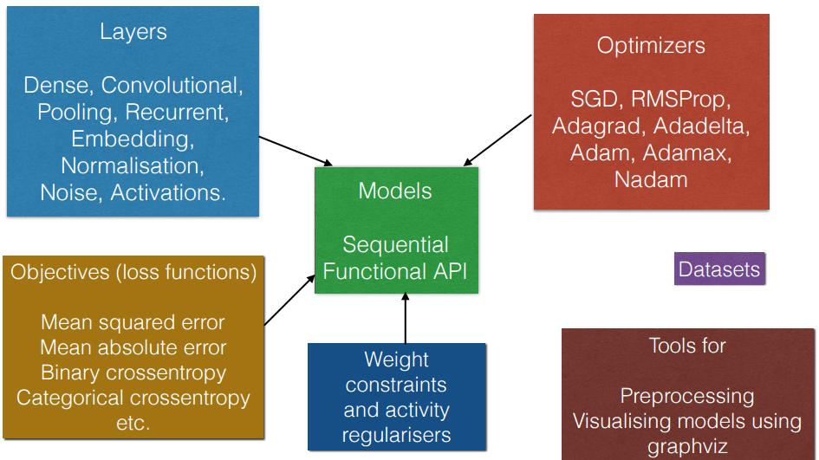
Kera’s components

Slide 24
Convolutional Neural Network

Slide 25
Import Necessary modules
Initialize random seed
Import sequential, core layers

Slide 26
Load data
(X_train, y_train), (X_test, y_test) = mnist.load_data()
Normalize data
X_train = X_train.astype('float32')
X_test = X_test.astype('float32')
X_train /= 255
X_test /= 255

Slide 27
1 hot encoding
Y_train = np_utils.to_categorical(y_train, 10)
Y_test = np_utils.to_categorical(y_test, 10)

Slide 28
Define the model
model = Sequential()
model.add(Convolution2D(32, 3, 3, activation='relu', input_shape=(1,28,28)))
model.add(Convolution2D(32, 3, 3, activation='relu'))
model.add(MaxPooling2D(pool_size=(2,2)))
model.add(Dropout(0.25))
model.add(Flatten())
model.add(Dense(128, activation='relu'))
model.add(Dropout(0.5))
model.add(Dense(10, activation='softmax'))

Slide 29
Compile the model
model.compile(loss='categorical_crossentropy', optimizer='adam', metrics=['accuracy'])
Fit the model
model.fit(X_train, Y_train,
batch_size=32, nb_epoch=10, verbose=1)
Evaluate the model
score = model.evaluate(X_test, Y_test, verbose=0)

Slide 30
Linear Regression

Slide 31
from keras.models import Sequential from keras.layers.core import Dense, Activation
model = Sequential() model.add(Dense(2,1,init=’uniform’, activation=’linear’)) model.compile(loss=’mse’, optimizer=’rmsprop’)
model.fit(X_train, y_train, nb_epoch=1000, batch_size=16,verbose=0) model.fit(X_train, y_train, nb_epoch=1, batch_size=16,verbose=1) score = model.evaluate(X_test, y_test, batch_size=16)

Slide 32
Gender Identification from voice

Slide 33
Read Data
DATA_PATH = "../input/voice.csv"
data = pd.read_csv(DATA_PATH, header = 0)
data.head(5)
data_values = data.values
data_input = data_values[0::, 0:20]
data_label = data_values[0::, 20]

Slide 34
One Hot Encoding
def labelToBinary(labels):
new_labels = []
for i in labels:
if i == 'male':
new_labels.append(0)
else:
new_labels.append(1)
return np.asarray(new_labels)
# Create a one hot vector from the numeric labels
def one_hot_encode(labels):
n_labels = len(labels)
n_unique_labels = len(np.unique(labels))
one_hot_encode = np.zeros((n_labels,n_unique_labels))
one_hot_encode[np.arange(n_labels), labels] = 1
return one_hot_encode

Slide 35
Model
def buildModel():
model = Sequential()
model.add(Dense(64, input_dim=20, init='uniform', activation='relu'))
model.add(Dropout(0.5))
model.add(Dense(64, activation='relu'))
model.add(Dropout(0.5))
model.add(Dense(2, activation='softmax'))
model.compile(loss='categorical_crossentropy', optimizer='adam', metrics=['accuracy'])
return model

